Slide 1
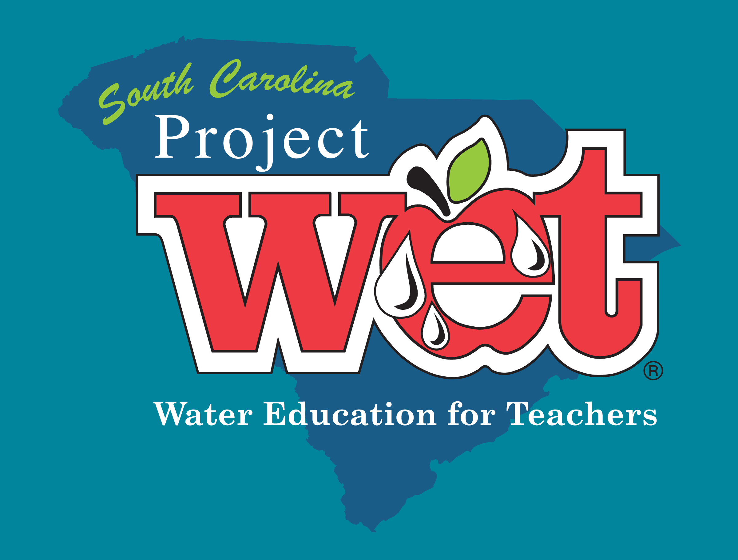

Slide 2
THE MISSION
The Mission of Project WET…
To reach children, parents, educators, and communities of the world with water education
informed people are more likely to participate in the decision making process and to make a difference through their actions.
Notes:
Maddi

Slide 3
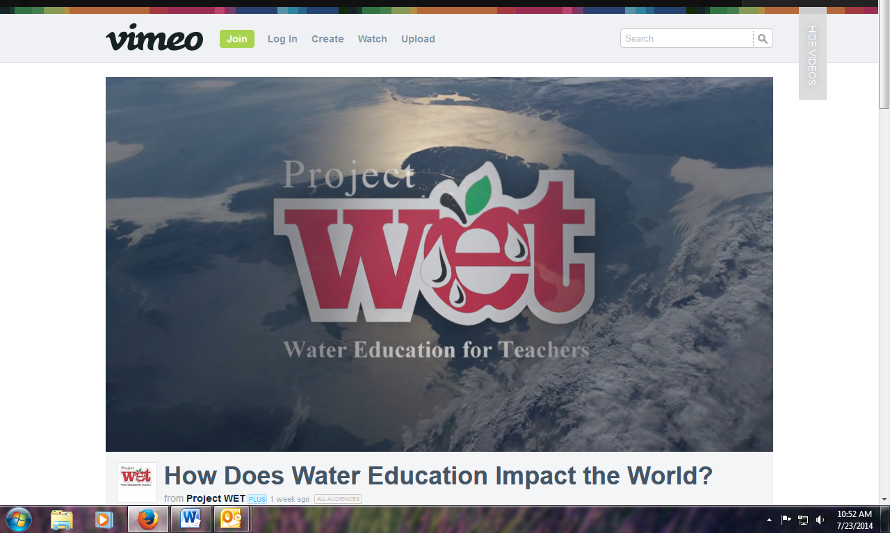

Slide 4
Core Beliefs
Project WET operates under a system of core beliefs
Water Connects Us All
Managing Water Sustainably
Water moves through living and nonliving systems and binds them together in a complex web of life.
Water resources management is crucial for providing tomorrow’s children with social and economic stability in a healthy and sustainable environment.
Connectivity
Sustainability
Water for All
Responsibility
Water for All Water Users
Personal Responsibility
Water of sufficient quality and quantity is vital for all water users (energy producers, farmers and ranchers, fish and wildlife, manufacturers, recreationists, rural and urban dwellers).
Awareness of and respect for water resources can encourage a personal, lifelong commitment of responsibility and positive community participation.
Notes:
Maddi
Judy Wortkoetter from Land Development / Wendy McNatt from Solid Waste

Slide 5
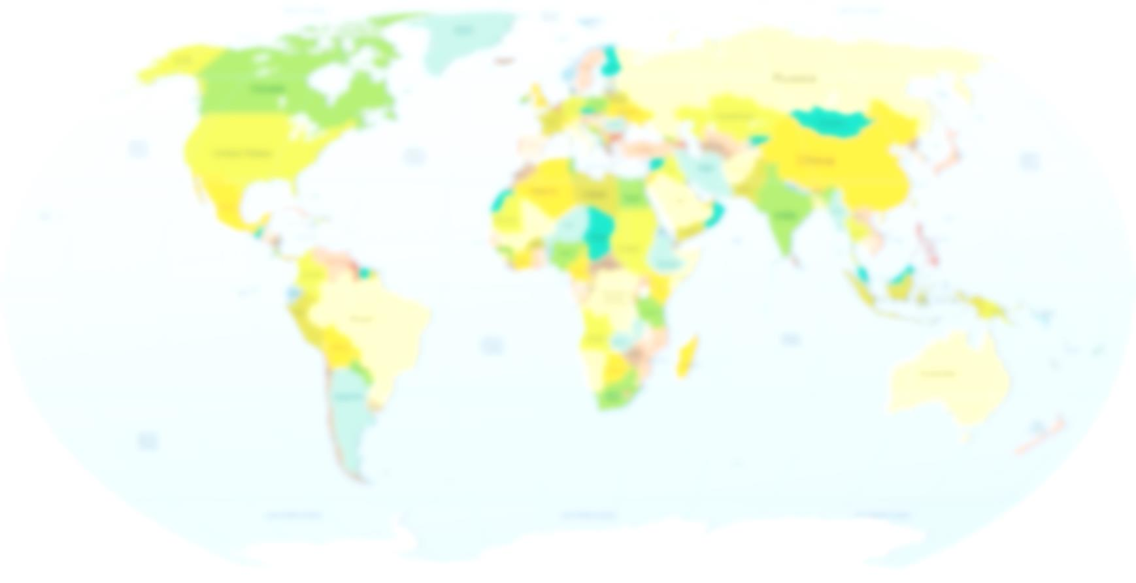
The Project WET Foundation
From our headquarters in Montana, we develop and deliver the world's best water education resources, organize special water events, manage a worldwide network of local implementing partners and advocate for the role of water education in solving the world's most pressing water issues.
 Project WET USA
 Canada
 Mexico
 Philippines
 Japan
 US Peace Corps
 American Samoa
 Argentina
 Cameroon
 France
 Italy
 Argentina
 Costa Rica
 Dominican Republic
 Fiji
 N. Marianas Islands
 Nigeria
 Palau
 Togo
 Uganda
 Ukraine
 Peru
Over 20 additional countries around the world partner with Project WET.
Notes:
Maddi – where did these goals come from? The permit of course!

Slide 6
The Project WET USA Network

The Project WET Foundation
Publishes water resource education materials that are appropriate for many different age groups and offer comprehensive coverage of the broad topic of water.

WET Coordinators
Provide leadership training, compile annual reports, participate in national teams to further develop PWET USA
WET Facilitators
Conduct Project WET workshops for Educators and are ambassadors to the program throughout the area/state.

WET Educators
Teachers, non-formal educators, municipal leaders, community members, boys and girls clubs, scouting groups, watershed associations, corporations, etc. use the curriculum and activities with students.

Notes:
Maddi – where did these goals come from? The permit of course!

Slide 7
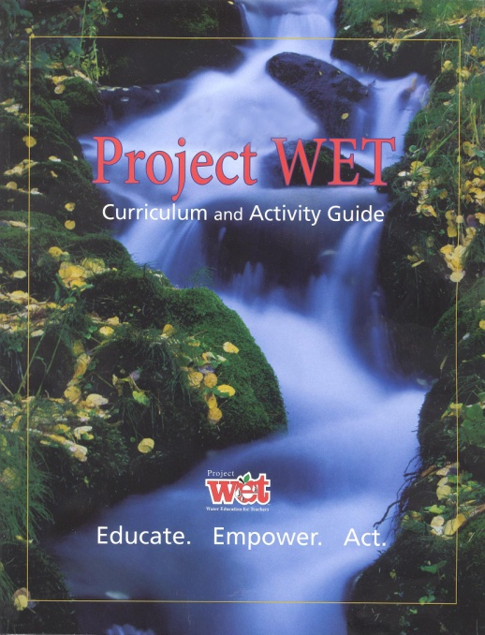
Project WET Workshops
Project WET Educators Guide
Can only be obtained by taking a workshop led by a Project WET Facilitator or Coordinator.
SHARE
PERFORM
Workshops are a minimum of 6 hours and include introduction, overview and practice with activities in the Guide.
PRACTICE
ENGAGE

Slide 8
Interdisciplinary
ART
MATH
SCIENCE
PE
WRITING
GOVERNMENT
HEALTH
STATISTICS
LANGUAGE
ARTS
SOCIAL
STUDIES
MUSIC
Activities are relevant and applicable to multiple subjects.

Slide 9
HISTORY
The History of EE in the USA
How Environmental Education Began and Flourished in the United States
Ever wonder how we got here?
Notes:
Maddi

Slide 10
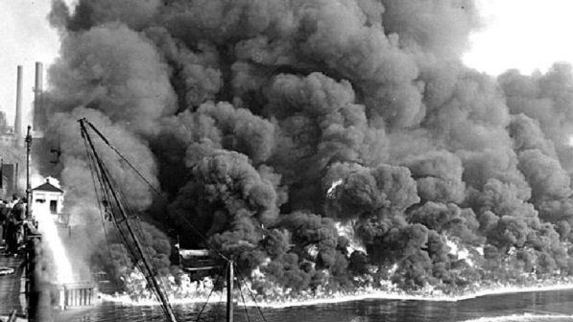
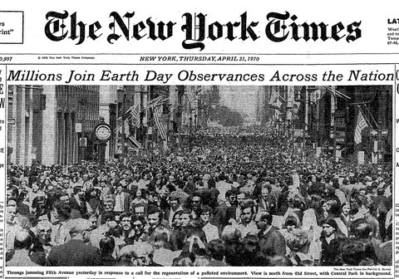
Environmental Education Timeline
Timeline overview of EE in the United States
Crisis on the Cuyahoga River
In June 1969, after a major Midwestern river actually caught fire, Americans finally began to get serious about the environment. The river had previously burned in 1948 and 1952.
1969
1970
First Earth Day Celebration
Earth Day 1970 gave voice to an emerging consciousness, channeling the energy of the anti-war protest movement and putting environmental concerns on the front page.
Notes:
Lynn

Slide 11
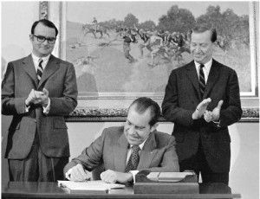
1970
EPA
The Environmental Protection Agency (EPA) was established under United States President Richard Nixon. The EPA’s mission is to protect human and environmental health.
Clean Water Act
The Federal Water Pollution Control Act of 1948 was the first major U.S. law to address water pollution. Growing public awareness and concern for controlling water pollution led to sweeping amendments in 1972, known as the Clean Water Act.
1972
1976
Project Learning Tree
PLT launched as a collaboration between the American Forest Institute (AFI)and the Western Regional Environmental Education Council (WREEC).
Notes:
Lynn

Slide 12
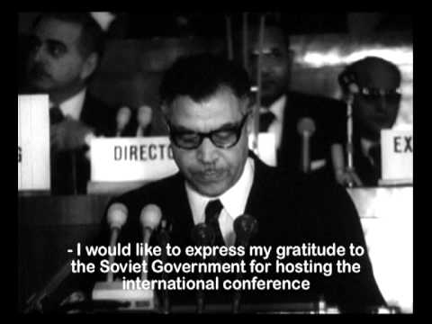
1977
UNESCO Meets in Tblisi
The Tbilisi Declaration noted the unanimous accord in the important role of environmental education in the preservation and improvement of the world's environment, as well as in the sound and balanced development of the world's communities.
2005
Project WET
he Project WET program was established in 1984 by the North Dakota State Water Commission in the agency's planning division to educate the public about water resources and its management.
Moving Forward
SC Project WET is growing an Educator and Facilitator Network in the state to increase water education and awareness!
Notes:
Lynn

Slide 13
EVOLUTION
How Has Project WET Evolved?
Guide 2.0, a website portal for educators, and other resources
Notes:
Maddi

Slide 14
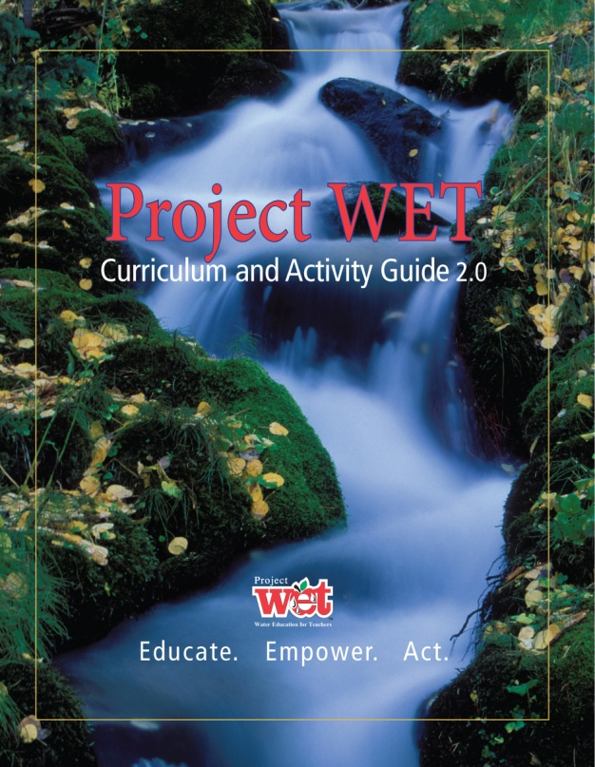
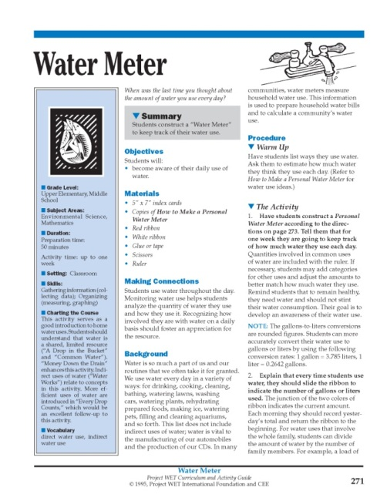
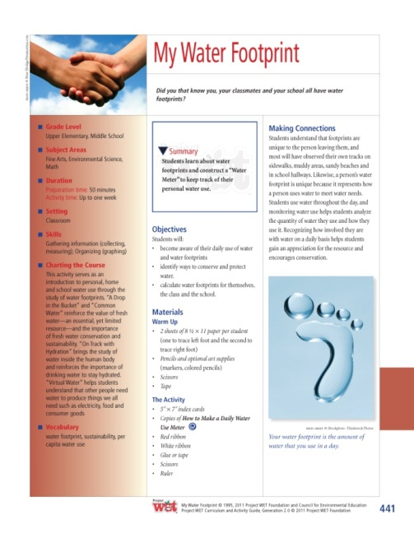
Project WET Guide Updates
Guide 2.0
In 2011, Project WET completely overhauled and upgraded the activity guide to its current version.

Slide 15
ONLINE RESOURCES
PORTAL
DiscoverWater.org
SCProjectWET.org
http://portal.projectwet.org/
Interactive online activities for kids to learn about all things water related.
Home of SC Project WET for facilitators and teachers.
Online resources to help you with Guide activities.

Slide 16
http://portal.projectWET.org
NGSS Correlations
Activity Resources & Copy Pages
Educator Library & Teacher Resources
Project WET Store

Slide 17
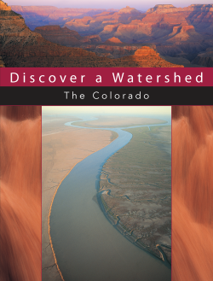
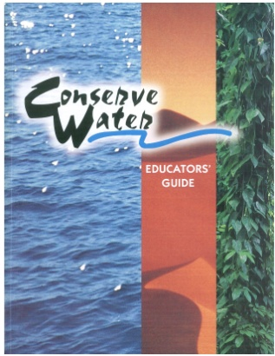
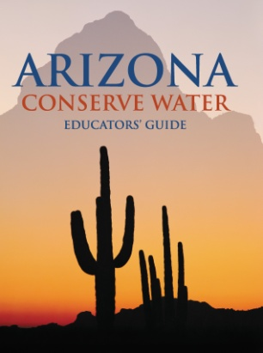
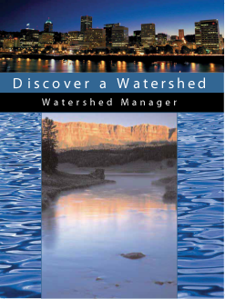
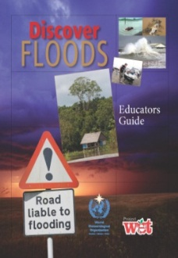
Additional Titles & Publications
Discover a Watershed
Series
Conserve Water & Arizona Conserve Water
Floods Series
Educators Guide
WOW (The Wonders of Wetlands)
Healthy Water, Healthy People

Slide 18
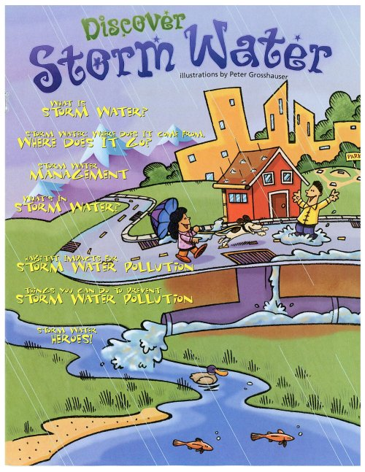
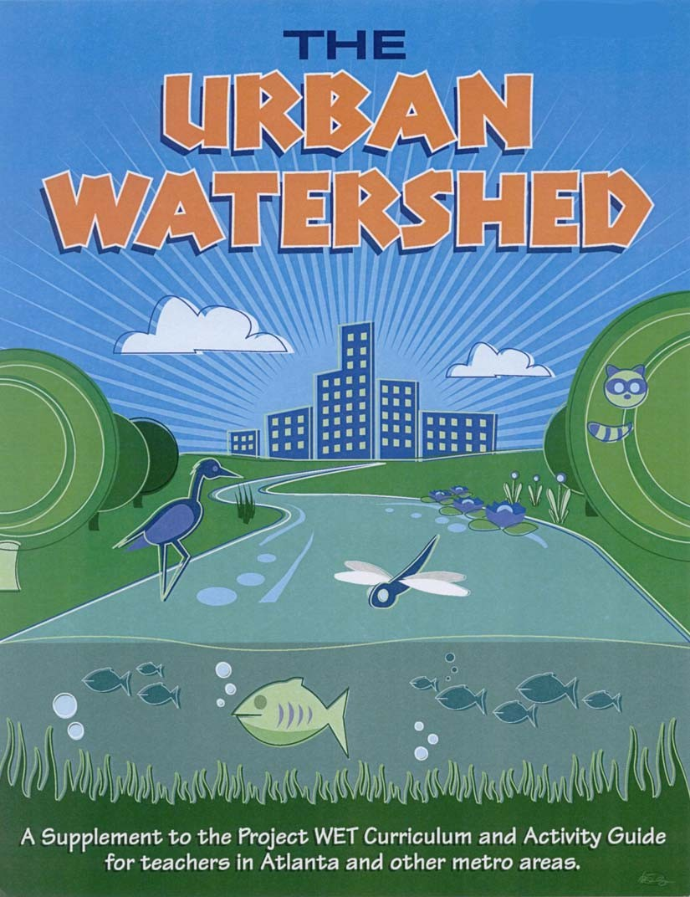
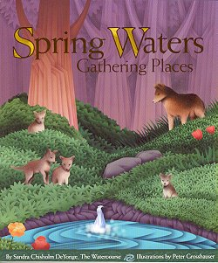
Children’s Activity Books / The Urban Watershed

Slide 19
GUIDE 2.0
Introducing the Activity Guide 2.0
Let’s “Splash Through The Guide” to learn about how it works!
A challenge that will help us explore all of the features that make it easy for educators to locate activities and appropriate information.
Notes:
Maddi

Slide 20
Splash Through The Guide Challenge
Find on which page the activity “Just Passing Through” is located. List the different ways you were able to find this activity.
What is ActionEducation TM?
For which grade levels are the activity “Poison Pump” appropriate? How did you find this out? What page and what reference?
Name 3 activities that could complement the learning in “Springing into Action”. How did you discover this information?
Turn to page xv, Activities Listed Alphabetically, found on pg 163 .
Turn to page x for definition. ActionEducation TM is education that empowers learners to take positive and appropriate action to solve a local water resource issue.
Middle School. Turn to Grade level Cross-Ref Chart, pg 554 or find the activity.
Find in Alphabetical listing (pg 203), refer to Charting the Course in purple box on left

Slide 21
Splash Through The Guide Challenge
What is the definition of Aquatic Invasive Species? Where did you find it?
Find three activities that could supplement a middle school Geography lesson that can be done in 30 minutes or less.
Find three writing activities that involve role-play. What reference did you use to find this information?
List an activity that you could use for your students that could easily correlate to your curriculum.
Glossary starts on page 566.
Blue Planet, Blue River, Discover the Waters of our NP, Drop in the Bucket, Seeing Watersheds
Subjects pg 550, Grade Level pg 554, Time Required pg 552.
Invaders!, Sum of the Parts, Super Bowl Surge
Teaching Methods, pg 556

Slide 22
EDUCATOR INFORMATION
For downloads and resources, educators can visit our special South Carolina educators page at:
http://scprojectwet.org/educator

Slide 23
Questions?
Home Page
www.scprojectwet.org
Telphone
864.920.6397
E-mail
lpilewski@greenvillecounty.org

